Slide 1


Charge-insensitive qubit design derived from the Cooper pair box (Section 1: From the Cooper pair box to the transmon)
Brant Norris*
Department of Electrical and Computer Engineering
Herbert Wertheim College of Engineering
University of Florida
*Email: brantnorris@ufl.edu

Slide 2
Outline
Introduction
From the Cooper Pair Box to the Transmon
The Cooper Pair Box
Introduction to the Transmon
Bridging the Gap from the CPB to the Transmon
Conclusion/Review
References

Slide 3

Introduction
Section 1

Slide 4
Introduction
Three types of superconducting Josephson Junction qubits, named based on their relevant degrees of freedom:
Charge
Flux
Phase
Strategies for enhancing dephasing times:
Improve the properties of junctions and materials to eliminate 1/f noise
Eliminate linear noise sensitivity (“sweet-spot” operation)
This paper follows the second strategy and proposes the transmon qubit
Similar to the Cooper Pair Box (CPB) qubit, but operated at a different ratio of Josephson energy to charging energy (E_{J}/E_{C})

Slide 5
Introduction
Quantities crucial to qubit operations:
Anharmonicity
Energy level charge dispersion
The magnitudes of these quantities are determined by the ratio of the Josephson energy to the charging energy (E_{J}/E_{C})
The transmon exploits the fact that charge dispersion reduces exponentially in E_{J}/E_{C} while the anharmonicity only decreases algebraically with a slow power law in E_{J}/E_{C}
This means by operating the transmon at a much larger E_{J}/E_{C} ratio than the Cooper Pair Box qubit, one can greatly reduce charge noise sensitivity in the qubit while only sacrificing a small amount of anharmonicity

Slide 6
Introduction
In order to better understand the transmon qubit, its creation, and its derivation let’s look at how we get from the CPB to the transmon

Slide 7
From the Cooper Pair Box to the Transmon
Section 2

Slide 8
The Cooper Pair Box
Section 2.1

Slide 9
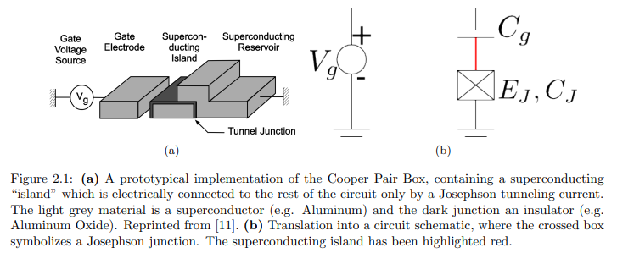
The Cooper Pair Box
The Cooper Pair Box is the prototypical charge qubit (the charge degree of freedom is used for coupling and interactions). In the late 1990’s, coherent quantum oscillations were demonstrated in this qubit type. The most simplistic form of the CPB involves a single superconducting “island” into which Cooper pairs may tunnel via a Josephson junction. This structure, and its circuit, can be seen in this figure.

Slide 10
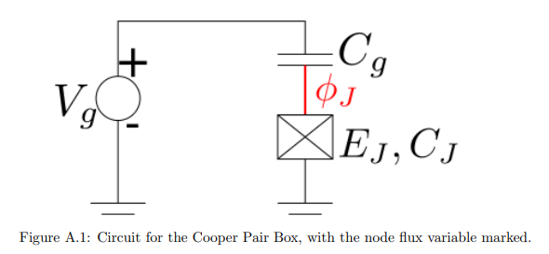
The Cooper Pair Box
In order to model the CPB, we should look at the system after removing the voltage source node. Thus, we are left with one non-ground node (with a node flux variable) as shown in this figure.

Slide 11


The Cooper Pair Box
Thus, the equation for the kinetic energy (T) will include a charging term for both capacitances:
Meanwhile, the potential energy (U) will include the Josephson energy and the source energy. Source energy is the gate voltage times the charge on the supply-side of the gate capacitor (V_{g} C_{g}). Thus, the potential energy is as follows:

Slide 12


The Cooper Pair Box
Since the Lagrangian is Kinetic minus Potential, it can be expressed as T – U, or:
The conjugate momentum is the charge in the island plus an effective offset charge gated by the source:

Slide 13


The Cooper Pair Box
Putting all of this together, we can find the Hamiltonian to be:
Often, this Hamiltonian is written in terms of the gauge invariant phase across the junction (δ):
Where C_{Σ} is the total capacitance of the island, Q_{J} is the charge in the island, and δ (delta) is the superconducting phase across the junction.

Slide 14

The Cooper Pair Box
The first term of this Hamiltonian represents the capacitive/charging energy, and the second term is the Josephson inductive energy. We can rewrite this expression with several useful quantities. The charging energy scale is set by E_{C} = e²/2C_{Σ} and we rephrase the charge variable in terms of n = Q_{j} / 2e (n being the number of Cooper pairs in the island). Thus, we obtain:
Where n_{g} = C_{Σ}V_{g} / 2e is referred to as the effective offset charge.

Slide 15
The Cooper Pair Box
That is how the Hamiltonian of the CPB is derived
The primary difference between the CPB and the transmon is the regime in which they are operated. While the CPB is operated in a regime in which E_{C} is often greater than E_{J} (especially in the case of the charge qubit), the transmon is operated in the regime of E_{J} >> E_{C}
The low E_{J}/E_{C} provides high anharmonicity, while a high E_{J}/E_{C} decreases qubit sensitivity to charge noise. Thus, there is a tradeoff to consider when tuning these values
However, as we will see with the transmon, the noise insensitivity can increase exponentially, while the anharmonicity will decrease with a weak power law. Thus, we must find a way to operate in the E_{J} >> E_{C} regime

Slide 16
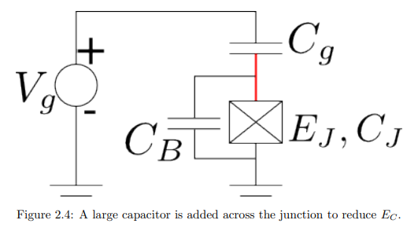
The Cooper Pair Box
By shunting the CPB with a capacitor, we can reduce the charge energy E_{C.} Thus, approaching the regime in which a transmon operates (E_{J} >> E_{C}). An example of this can be seen in the figure below.

Slide 17
Introduction to the Transmon
Section 2.2

Slide 18
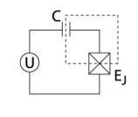
Introduction to the Transmon
A transmon qubit is created using two superconducting “islands”. A superconducting island is formed by the superconducting electrodes between the gate capacitor and the junction capacitance.
An example of a superconducting island can be seen in the adjacent diagram
“U” is the gate voltage, C is the gate capacitance, and E_{J} is the Josephson energy at the Josephson junction

Slide 19
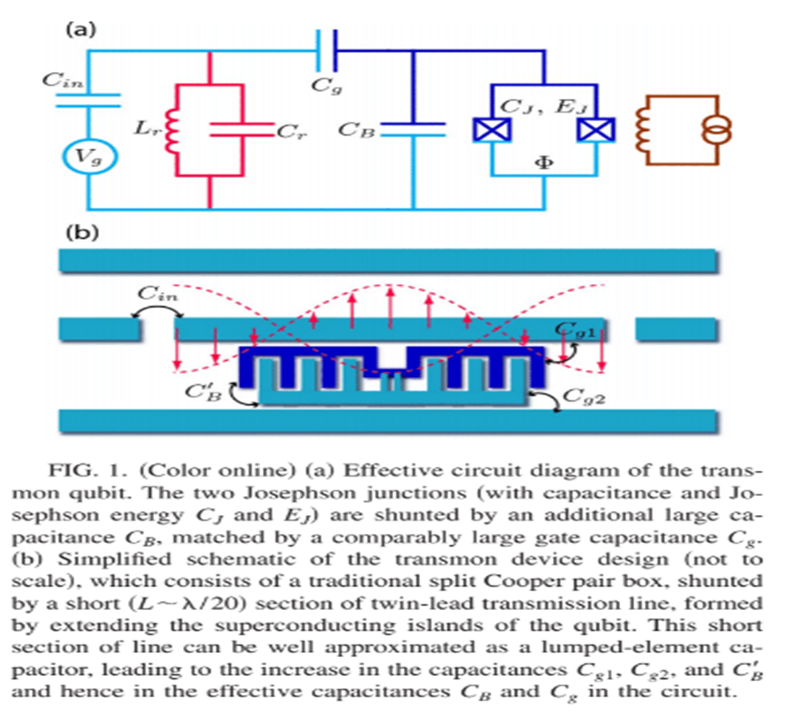
Introduction to the Transmon
The transmon qubit consists of two separate superconducting systems (referred to as “islands”) coupled together through two Josephson junctions. These islands can be seen in the image to the left.

Slide 20
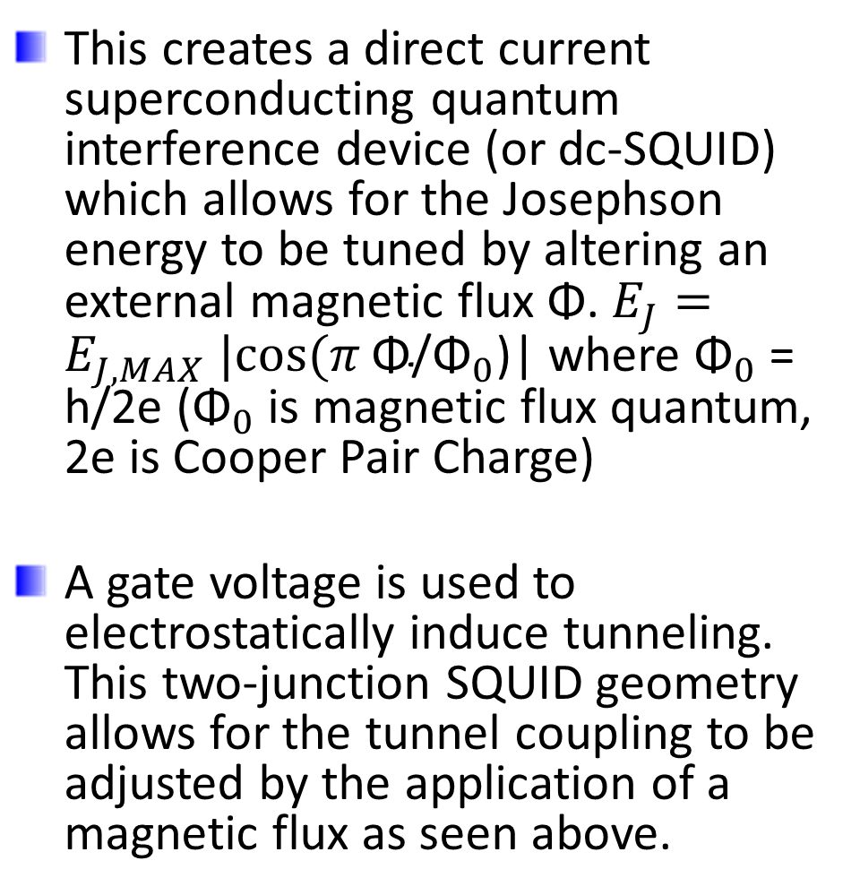
Introduction to the Transmon
This creates a direct current superconducting quantum interference device (or dc-SQUID) which allows for the Josephson energy to be tuned by altering an external magnetic flux Φ. $E_{J}=E_{J,MAX} |cos⁡(π \text{Φ}\text{/}{\text{Φ}}_{0}\text{)}$| where ${\text{Φ}}_{0}$ = h/2e (${\text{Φ}}_{0}$ is magnetic flux quantum, 2e is Cooper Pair Charge)
A gate voltage is used to electrostatically induce tunneling. This two-junction SQUID geometry allows for the tunnel coupling to be adjusted by the application of a magnetic flux as seen above.

Slide 21
Introduction to the Transmon
The effective offset charge of the device (given by n_{g}) measured in units of the Cooper pair charge 2e is controlled by a gate electrode capacitively coupled to the ‘island’ such that the effective offset charge:
n_{g} = Q_{r} /2e + C_{g}V_{g} / 2e
Where Q_{r} represents the environment-induced offset charge. C_{g} and V_{g} represent the gate voltage and capacitance.
This is because the CPB is a superconducting island with a gate induced polarization charge of C_{g}V_{g}/e which is the preferred amount of excess island charge in electrons. Thus, adding this equation substituting e for the CPB charge of 2e, and adding the environment-induced offset charge, we get the above equation for the effective offset charge n_{g}. (Gate and environment charges summed in numerator, Cooper charge in denominator).

Slide 22

Introduction to the Transmon
The crucial modification that separates the transmon from the CPB is a shunting connection of the two superconductors via a large capacitance C_{B}, accompanied by a similar increase in the gate capacitance C_{g.}

Slide 23

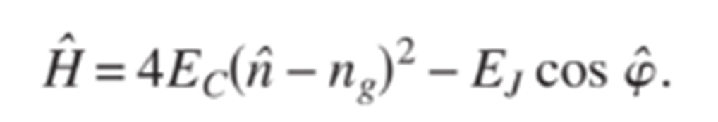
Introduction to the Transmon
The gate voltage causes an electrostatic frustration of the Cooper box with a Hamiltonian given as follows, where N is the quantized integer number of excess Cooper pairs:
Subtracting the Josephson energy in the phase basis, this takes a form similar to the stationary Schrodinger equation. Thus, the Hamiltonian for the system can be given in a simple form as:
n is the number of Cooper pairs transferred between the islands and φ (phi) is the gauge-invariant phase difference between the superconductors

Slide 24

Introduction to the Transmon
n is number of Cooper pairs transferred between the islands and φ is the gauge-invariant phase difference between the superconductors

Slide 25
Introduction to the Transmon
This Hamiltonian may look familiar. That’s because it is identical to that of the CPB that we derived earlier.
n is number of Cooper pairs transferred between the islands and φ is the gauge-invariant phase difference between the superconductors

Slide 26
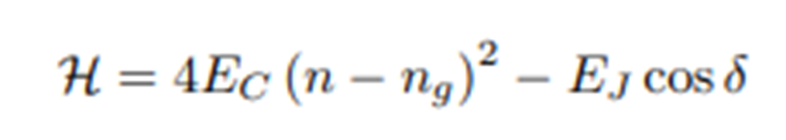
Introduction to the Transmon
As we can see, these Hamiltonians are the same:

Slide 27
Introduction to the Transmon
This is because the CPB and the transmon are exceptionally similar qubits. The primary difference lies in the regime in which they operate. (transmon operates in E_{J} / E_{c} >> 1, whereas CPB operates with a much higher E_{C}), plus generally the transmon utilizes an extra superconducting island. The change in regime is often created and manipulated utilizing a shunting capacitor.

Slide 28
Bridging the Gap from the CPB to the Transmon
Section 2.3

Slide 29
Bridging the Gap from the CPB to the Transmon
Starting with the CPB Hamiltonian, if we operate it in a different regime of ratio E_{J}/E_{C}, it is possible to have a qubit that is optimized with respect to 1/f charge noise effects. This is because when E_{J} is significantly greater than E_{C} the CPB system begins to behave as an anharmonic oscillator. As long as the ratio does not become too large, in which case it behaves as a harmonic oscillator (more on this in a moment).
Adding a shunting capacitor can decrease E_{C} and move us closer to the E_{J}/E_{C} >> 1 regime in which the transmon operates.

Slide 30

Bridging the Gap from the CPB to the Transmon
Due to the shunting (parallel) nature of the capacitors in the circuit, the capacitances in the circuit can simply be added up to give the total capacitance. This is shown in the following equation (as described in the CPB section of the presentation earlier, this is the charging energy scale):
Thus, we can utilize the additional capacitance C_{B} (shunting capacitor) as an independent variable to tune the charging energy of the system (similar to a degree of freedom). Thus, the charging energy E_{C} can be made small compared to the Josephson energy by means of the additional capacitance C_{B}.

Slide 31
Bridging the Gap from the CPB to the Transmon
As E_{J}/E_{C} increases, the charge insensitivity also increases. However, the anharmonicity decreases. Thus, we must balance E_{J}/E_{C} to achieve both sufficient anharmonicity and sufficient charge insensitivity. Therefore, the behavior of the CPB as an anharmonic oscillator as E_{J}/E_{C} increases is exploitable. Especially since the charge insensitivity increases significantly quicker than the anharmonicity decreases.

Slide 32
Bridging the Gap from the CPB to the Transmon
Anharmonicity is important because a harmonic oscillator involves uniformly spaced, discrete levels. Thus, an excitation to the first transition would also excite the second, and so on. In order for a qubit to be useful in computation, it must be possible to address only the transition between the levels that store information, so it must be sufficiently anharmonic.

Slide 33

Bridging the Gap from the CPB to the Transmon
Why does charge noise insensitivity increase exponentially, but anharmonicity decreases with a weak power law?
This phenomenon occurs because after utilizing an oscillator analogy and simplifying the transmon Hamiltonian, we find that for the transmon qubit the anharmonic term which comes from the E_{J} term in the original Hamiltonian only depends on E_{C}.
This leads to the fact that at large values of E_{J}/E_{C} the anharmonicity approaches:

Slide 34


Bridging the Gap from the CPB to the Transmon
Now for the derivation and background of why this occurs:
To begin, we rewrite the CPB/transmon Hamiltonian as follows:
Using an analogy of a harmonic oscillator, we can expand the cosine potential of this Hamiltonian as a power series:

Slide 35


Bridging the Gap from the CPB to the Transmon
Hamiltonians can be written in terms of dimensionless operators (especially when describing quantized oscillators). For example:
Where the photon annihilation operator (a) is given as:

Slide 36
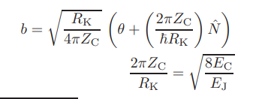
Bridging the Gap from the CPB to the Transmon
Using this idea, the harmonic oscillator portion can be re-expressed in dimensionless units as follows:
Where R_{K} = h / 4e² is a constant known as the resistance quantum
This is due to the fact that when we quantize an LC oscillator, equations take this form with the dimensionless units and operators.

Slide 37
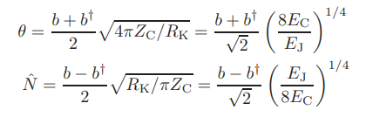

Bridging the Gap from the CPB to the Transmon
Writing the phase θ in terms of the dimensionless operators, similar to the Hamiltonian on the last slide, we obtain:
Substituting the phase into the Hamiltonian we get:

Slide 38

Bridging the Gap from the CPB to the Transmon
We can then simplify to a first-order approximation (perturbation theory says we can simplify to first-order by only using the diagonal matrix elements). Thus, we can only collect the diagonal terms from the (b + b†)⁴. This means it can be written in the form (b† b)². Plugging in these terms we find the energy of the j^{th} level to be as follows:

Slide 39
Bridging the Gap from the CPB to the Transmon
We can see from this equation that the last term (the anharmonic term) now only depends upon E_{C}. This means that we can increase E_{J} without decreasing the anharmonicity. Thus, we can choose E_{C} as needed in order to ensure sufficient anharmonicity, then choose an E_{J} to ensure that E_{J}/E_{C} is sufficiently large to operate in the transmon regime and provide sufficient charge noise insensitivity.

Slide 40
Bridging the Gap from the CPB to the Transmon
This is the phenomenon that the transmon exploits in order to generate sufficient charge noise insensitivity while still maintaining sufficient anharmonicity.

Slide 41
Conclusion/Review
Section 3

Slide 42
Conclusion/Review
The main difference between the CPB and the transmon is the regime in which they operate, the transmon operates in a significantly higher E_{J}/E_{C}
In order to minimize the E_{C} and move toward this regime, a shunting capacitor is added to the CPB to decrease E_{C}
This leads to the transmon qubit, which exploits a mathematical phenomenon where charge noise insensitivity increases exponentially while anharmonicity only decreases with a weak power law

Slide 43
References
Section 4

Slide 44
References
J. Koch, et al. Charge-insensitive qubit design derived from the Cooper pair box. Physical Review A, 2007.
D. Schuster. Circuit Quantum Electrodynamics. Yale University, 2007.
J. Moy Chow. Quantum Information Processing with Superconducting Qubits. Yale University, 2010.
S. Bader. The Transmon Qubit. 2013.

